Slide 1
Chapter 2 Software Processes

Slide 2
Agenda
Software process.
Software process models.
Software process activities.
Coping with change.

Slide 3
The software process
Software process: a structured set of activities required to develop a software system.
Many different software processes but all involve:
Specification – defining what the system should do.
Design and implementation – defining the organization of the system and implementing the system.
Validation – checking that it does what the customer wants.
Evolution – changing the system in response to changing customer needs.

Slide 4
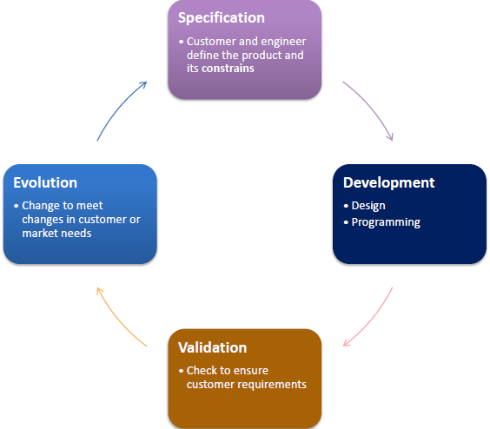
Software Process Activities

Slide 5
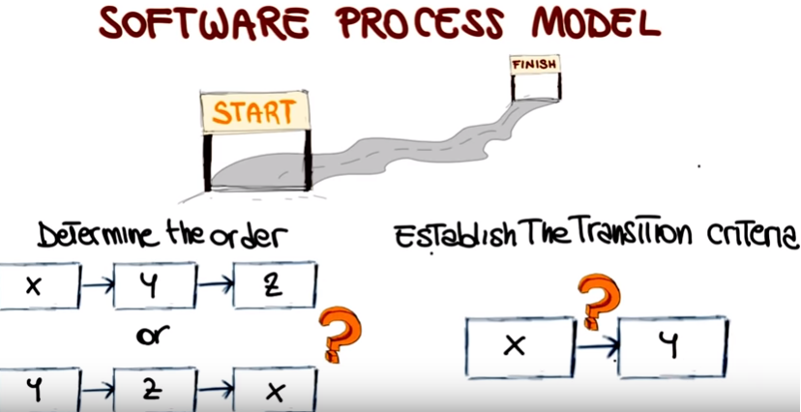
The software process model
is an abstract representation of a process.
presents a description of a process from some particular perspective.

Slide 6
Software processes category
Sometimes, software processes are categorized as either plan-driven or agile processes.
Plan-driven processes are processes where all of the process activities are planned in advance and progress is measured against this plan.
In agile processes, planning is incremental and it is easier to change the process to reflect changing customer requirements.
In practice, most practical processes include elements of both plan-driven and agile approaches.
There are no right or wrong software processes.

Slide 7
Software process models
The waterfall model
Plan-driven model.
Incremental (exploratory) development
May be plan-driven or agile.
Reuse-oriented software engineering
May be plan-driven or agile.

Slide 8
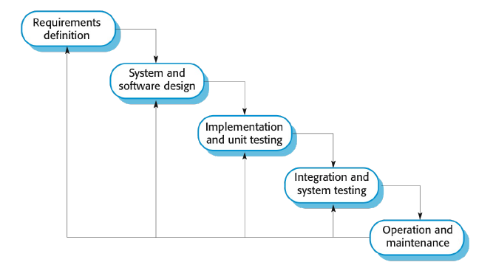
The waterfall model
Notes:
https://www.youtube.com/watch?v=5A5XCuWMG4o

Slide 9
Waterfall model phases
The waterfall model is an example of a plan-driven process
you must plan and schedule all of the process activities before starting work on them.
There are separate identified phases in the waterfall model:
Requirements analysis and definition
System and software design
Implementation and unit testing
Integration and system testing
Operation and maintenance

Slide 10
Waterfall model phases
The waterfall model is mostly used for large systems engineering projects where a system is developed at several sites.
In those circumstances, the plan-driven nature of the waterfall model helps coordinate the work.

Slide 11
Waterfall model problems
Waterfall model is the difficulty of accommodating change after the process is underway.
In principle, a phase has to be complete before moving onto the next phase.

Slide 12
Waterfall model problems
Inflexible partitioning of the project into distinct stages makes it difficult to respond to changing customer requirements.
Therefore, this model is only appropriate when the requirements are well-understood and changes will be fairly limited during the design process.
Few business systems have stable requirements.

Slide 13
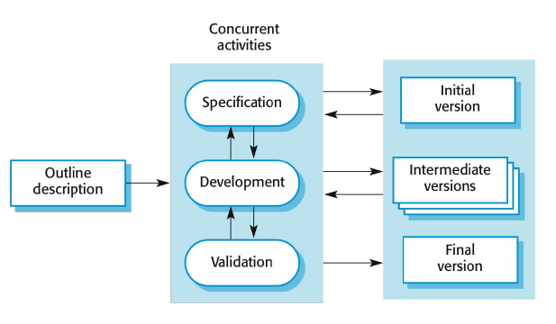
Incremental (exploratory) development

Slide 14
Incremental development
Incremental development is based on the idea of developing an initial implementation, exposing this to user comment and evolving it through several versions until an adequate system has been developed.
Incremental software development, which is a fundamental part of agile approaches, is better than a waterfall approach for most business, e-commerce, and personal systems.

Slide 15
Incremental development
Incremental development in some form is now the most common approach for the development of application systems.
This approach can be either plan-driven, agile, or, more usually, a mixture of these approaches.
In a plan-driven approach, the system increments are identified in advance;
if an agile approach is adopted, the early increments are identified but the development of later increments depends on progress and customer priorities.

Slide 16
Incremental development benefits
The cost of accommodating changing customer requirements is reduced.
The amount of analysis and documentation that has to be redone is much less than is required with the waterfall model.
It is easier to get customer feedback on the development work that has been done.
Customers can comment on demonstrations of the software and see how much has been implemented.
More rapid delivery and deployment of useful software to the customer is possible.
Customers are able to use and gain value from the software earlier than is possible with a waterfall process.

Slide 17
Incremental development problems
The process is not visible.
Managers need regular deliverables to measure progress.
System structure tends to degrade as new increments are added.
Unless time and money is spent on refactoring to improve the software, regular change tends to corrupt its structure.
Incorporating further software changes becomes increasingly difficult and costly

Slide 18
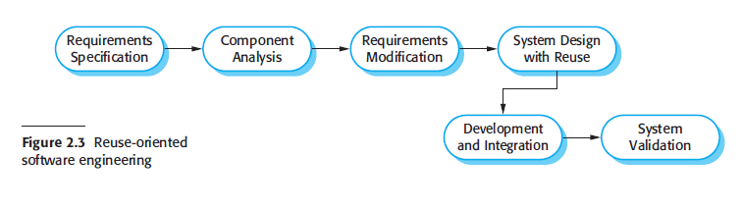
Reuse-oriented software engineering

Slide 19
Reuse-oriented software engineering
Based on systematic reuse where systems are integrated from existing components or COTS (Commercial-off-the-shelf) systems.
Process stages
Component analysis
Requirements modification
System design with reuse
Development and integration.
Reuse is now the standard approach for building many types of business system.
Notes:
Short for commercial off-the-shelf, an adjective that describes software or hardware products that are ready-made and available for sale to the general public. For example, Microsoft Office is a COTSproduct that is a packaged software solution for businesses.
1. Component analysis Given the requirements specification, a search is made for
components to implement that specification. Usually, there is no exact match and
the components that may be used only provide some of the functionality required.
2. Requirements modification During this stage, the requirements are analyzed using
information about the components that have been discovered. They are then modified
to reflect the available components. Where modifications are impossible, the
component analysis activity may be re-entered to search for alternative solutions.
3. System design with reuse During this phase, the framework of the system is
designed or an existing framework is reused. The designers take into account the
components that are reused and organize the framework to cater for this. Some
new software may have to be designed if reusable components are not available.
4. Development and integration Software that cannot be externally procured is
developed, and the components and COTS systems are integrated to create the
new system. System integration, in this model, may be part of the development
process rather than a separate activity.

Slide 20
Coping with change
Change is inevitable in all large software projects.
Business changes lead to new and changed system requirements
New technologies open up new possibilities for improving implementations
Changing platforms require application changes
Change leads to rework so the costs of change include both rework (e.g. re-analysing requirements) as well as the costs of implementing new functionality
Notes:
An application is computer software designed to help a user perform specific tasks.
A computing platform includes a hardware architecture and a software framework that allow application software to run—for example, the operating system and programming languages.

Slide 21
Reducing the costs of rework
Change avoidance, where the software process includes activities that can predict possible changes before significant rework is required.
For example, a prototype system may be developed to show some key features of the system to customers.
Change tolerance, where the process is designed so that changes can be accommodated at relatively low cost.
This normally involves some form of incremental development.
Proposed changes may be implemented in increments that have not yet been developed.
If this is impossible, then only a single increment (a small part of the system) may have be altered to incorporate the change.

Slide 22
Software prototyping
A prototype is an initial version of a system used to demonstrate concepts and try out design options.
A prototype can be used in:
The requirements engineering process to help with requirements elicitation and validation
In design processes to explore options and develop a UI design

Slide 23
Benefits of prototyping
Improved system usability.
A closer match to users’ real needs.
Improved design quality.
Improved maintainability.
Reduced development effort

Slide 24
Task: additional software process models
Incremental delivery
Boehm’s spiral model
The Rational Unified Process RUP.

Slide 25
Summary
Software process
Plan-driven processes
Software process model
Waterfall’ model
Software Process Activities
Specification
Validation
Agile processes
Incremental (exploratory) development
Reuse-oriented development
Development
Evolution

